Slide 1
Statistical Methods for Decision Making

Slide 2
Agenda:
Test of Mean:
A. One sample Z & t Test
B. Two samples Independent Z & t Test
C. Paired/Dependent t Test
D. Equivalent non parametric test( Mann Whitney & Wilcoxon signed rank test)
Test of Proportion:
A. One Sample Z proportion Test
B. Two Sample Z proportion Test

Slide 3
One-Sample, Two-Sample and Paired Sample tests
One Sample test | It is a statistical procedure used to determine whether a sample of observations could have been generated by a process with a specific mean.
Two Sample test | It is applied to compare whether the average difference between two groups (independent samples) is significant.
Paired Sample test | It is used to compare two population means where you have two samples in which observations in one sample can be paired with observations in the other sample.

Slide 4
One Sample test

Slide 5
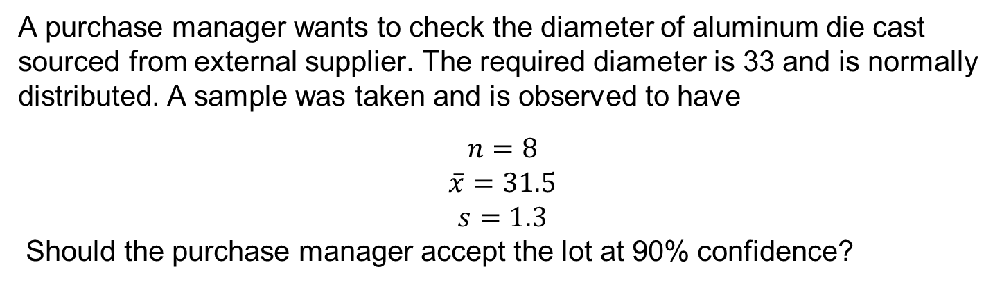
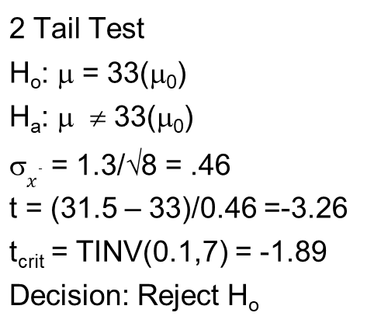
Hypothesis Testing – Small Sample σ Estimated
A purchase manager wants to check the diameter of aluminum die cast sourced from external supplier. The required diameter is 33 and is normally distributed. A sample was taken and is observed to have
$$n=8$$
$$\overline{x}=31.5$$
$$s=1.3$$
Should the purchase manager accept the lot at 90% confidence?
2 Tail Test
H_{o}: μ = 33(μ₀)
H_{a}: μ ≠ 33(μ₀)
σ$\overline{x}$ = 1.3/√8 = .46
t = (31.5 – 33)/0.46 =-3.26
t_{crit} = TINV(0.1,7) = -1.89
Decision: Reject H_{o}

Slide 6
One Sample – Z test

Slide 7
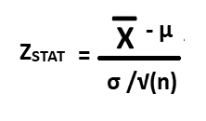
One-Sample test
Z test for Mean (σ known)
where X- is the mean of the sample
µ is the mean of the population
σ is the standard deviation of the population
n is the number of observations

Slide 8
One-Sample test - Z test for Mean (σ known)
A Pizza restaurant claims that the average delivery time of pizza is 20 minutes with the Standard deviation of 12 minutes. A sample of 30 pizza delivery times is given below:
38, 38, 10, 10, 10, 10, 10, 38, 10, 38, 10, 10, 10, 10, 10, 38, 10, 38, 10, 38, 38, 38, 10, 38, 38, 38, 38, 10, 10, 38
Test whether there is a significant deviation between your sample mean and the population mean?
Solution
We observe from the sample, sample mean = 692 / 30 = 23.07
n = 30
µ = 20 and σ = 12

Slide 9
One-Sample test - Z test for Mean (σ known)
Step 1: State the null and alternative hypothesis
H0: µ ≤ 20 minutes
HA: µ > 20 minutes
Step 2: Choose the level of significance, α to be 5% and sample size is 30
Step 3: Choose the appropriate test statistic. Since σ is known, you use the normal distribution and ZSTAT as test statistic.
Step 4: Determine the critical value that divides the rejection and non-region regions.
Critical values are selected so that the rejection region contains a total area of α when H0 is true and the non-rejection region contains a total area of 1 - α when H0 is true. Since α = 0.05, the critical value of ZSTAT is 1.65.

Slide 10
One-Sample test - Z test for Mean (σ known)
Critical value
Step 5: Collect the data, organize the results and compute the value of the test statistic.
Z = (23.07 - 20) / (12 / sqrt(30)) = 1.40
Step 6: State the statistical decision and the managerial conclusion.
Z_{STAT} is in the region of rejection because Z_{STAT} < Z_{CRITICAL} (=1.65) where Z_{STAT} = 1.40
Because the test statistic falls in the non-rejection region, the statistical decision is to accept the null hypothesis.
The managerial conclusion is that insufficient evidence exists to prove that pizza delivery time is different from the claimed delivery time of 20 minutes. No Corrective action on delivery process is required.

Slide 11
One-Sample test - Z test for Mean (σ known)
P value approach
Step 5: Collect the data, organize the results and compute the p value of the test statistic.
Z = (23.07 - 20) / (12 / sqrt(30)) = 1.40
P(X > Z = 1.40) = 1 – 0.9192 = 0.0808
Step 6: State the statistical decision and the managerial conclusion.
Since P-value (0.0808) > 0.05 (our level of significance), we accept null hypothesis.
So statistical decision is to accept the null hypothesis.
The managerial conclusion is that insufficient evidence exists to prove that pizza delivery time is different from the claimed delivery time of 20 minutes. No Corrective action on delivery process is required.

Slide 12
One Sample – t test

Slide 13
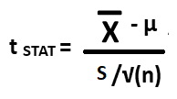
One Sample - t test for Mean (σ unknown)
where is the mean of the sample
µ is the mean of the population
s is the Sample standard deviation
n is the number of observations
Here, t follows a t distribution having n-1 degrees of freedom

Slide 14
One-Sample test - t test for Mean (σ unknown)
Example: Consider amount from Sales invoice of a nearby restaurant given the population mean is 120 USD.
108.98, 152.22, 111,45, 110.59, 127.46, 107.26, 93.32, 91.97, 111.56, 75.71, 128.58, 135.11
Test whether there is a significant deviation between your sample mean and the population mean?
Solution:
We observe from the sample,
Sample mean = 1354.21 / 12 = 112.85
Sample Std. deviation = 20.80
n = 12
µ = 120
s = 20.80

Slide 15
One-Sample test - t test for Mean (σ unknown)
Step 1: State the null and alternative hypothesis
H0: µ = 120
HA: µ ≠ 120
Step 2: Choose the level of significance, α to be 5% and sample size is 12
Step 3: Choose the appropriate test statistic. Since σ is unknown, you use the t distribution and t_{STAT} as test statistic.
Step 4: Determine the critical value that divides the rejection and non-region regions.
For a given sample size n, the test statistic follows a t distribution with n-1 degrees of freedom. The alternative hypothesis has inequality sign and therefore has two tails. The area of rejection of the t distribution's left (lower) tail is 0.025, and the area in the rejection region of the t distribution's right (upper) tail is also 0.025. The t critical values are (-2.201 and 2.201) for 11 degrees of freedom at 5 % level of significance.

Slide 16
One-Sample test - t test for Mean (σ unknown)
Using Critical Value approach
Step 5: Collect the data, organize the results and compute the value of the test statistic.
t = (112.85 - 120) / (20.80 / sqrt(12)) = -1.191
Step 6: State the statistical decision and the managerial conclusion.
t is not in the region of rejection because t_{STAT} < t_{CRITICAL} (-2.201) where t = - 1.191 Because the test statistic falls in the non-rejection region, the statistical decision is not to reject the null hypothesis.
The managerial conclusion is that insufficient evidence exists to prove that mean amount per invoice has changed.
No Corrective action on sales process is required.

Slide 17
One-Sample test - t test for Mean (σ unknown)
P value approach
Step 5: Collect the data, organize the results and compute the p value of the test statistic.
t = (112.85 - 120) / (20.80 / sqrt(12)) = -1.1908
P(X > t = -1.1908, 11 df) = 0.259
Step 6: State the statistical decision and the managerial conclusion.
Since P-value (=0.259) > 0.05 (our level of significance), we do not reject null hypothesis. So statistical decision is not to reject the null hypothesis.
The managerial conclusion is that insufficient evidence exists to prove tha mean amount per invoice has not changed.
No Corrective action on sales process is required.

Slide 18
Two Sample Test

Slide 19
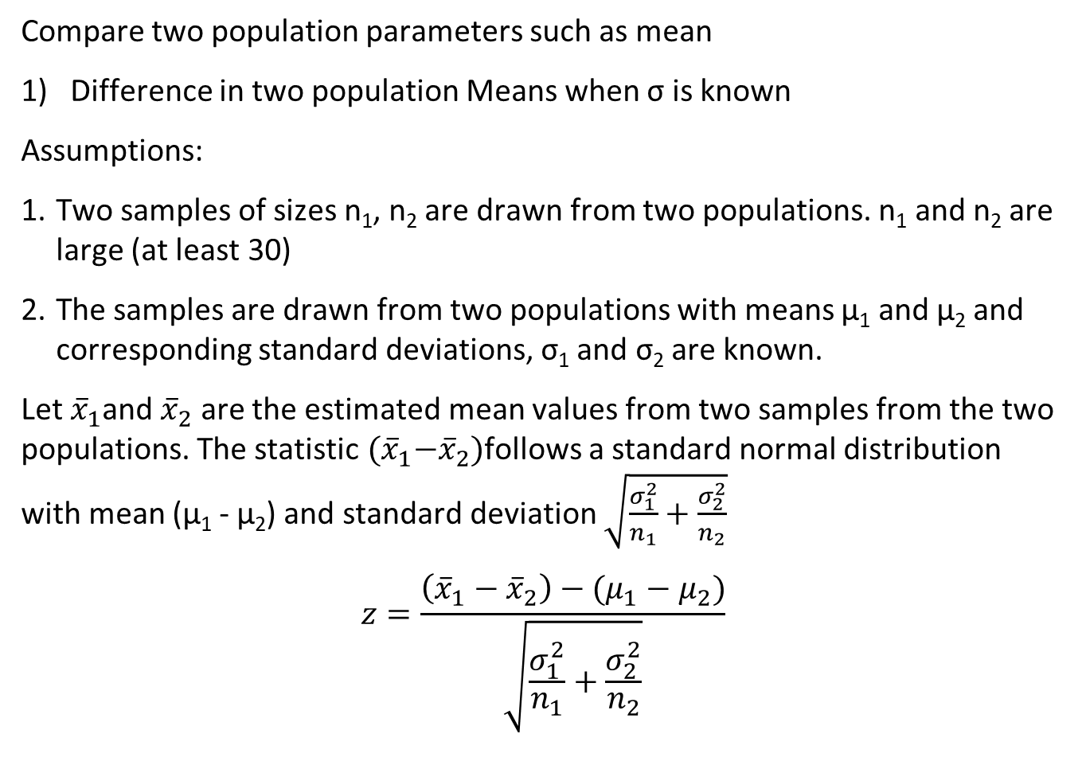
Two Sample Test
Compare two population parameters such as mean
1) Difference in two population Means when σ is known
Assumptions:
Two samples of sizes n₁, n₂ are drawn from two populations. n₁ and n₂ are large (at least 30)
The samples are drawn from two populations with means µ₁ and µ₂ and corresponding standard deviations, σ₁ and σ₂ are known.
Let ${\overline{x}}_{1}$and ${\overline{x}}_{2}$ are the estimated mean values from two samples from the two populations. The statistic ${(\overline{x}}_{1}−{\overline{x}}_{2})$follows a standard normal distribution with mean (µ₁ - µ₂) and standard deviation $\sqrt{\frac{σ_{1}^{2}}{n_{1}}+\frac{σ_{2}^{2}}{n_{2}}}$
$$z=\frac{\left({\overline{x}}_{1}−{\overline{x}}_{2}\right)−(μ_{1}−μ_{2})}{\sqrt{\frac{σ_{1}^{2}}{n_{1}}+\frac{σ_{2}^{2}}{n_{2}}}}$$

Slide 20
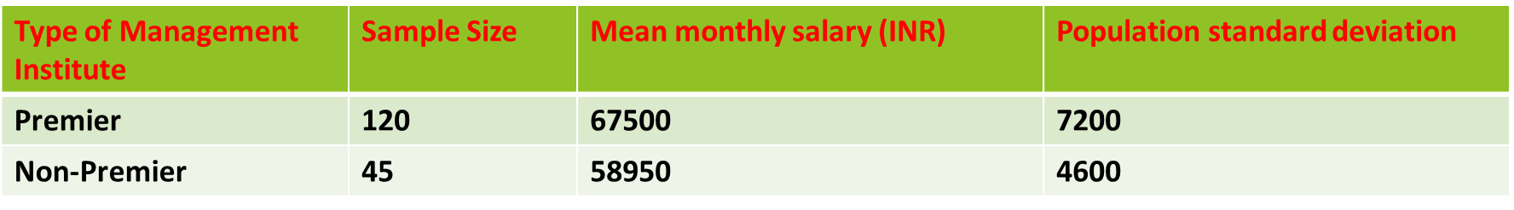
Two-Sample test - Z test for Mean (σ known)
Example: Salary of Management trainees with MBA from Premier institute and other institutes are given below:
Assume that the salary of Management trainees with MBA from Premier and non-Premier institutes follow normal distribution.
Check whether the difference in monthly salary is at least 5000 or more for Management trainees with MBA from Premier Institutes.

Slide 21

Two-Sample test - Z test for Mean (σ known)
Solution
We observe from the data,
n1 = 120 and n2 = 45
σ₁ = 7200; σ2 = 4600
Step 1: State the null and alternative hypothesis
H₀: µ1 - µ2 ≤ 5000
H_{a}: µ1 - µ2 > 5000
Step 2: Choose the level of significance, α to be 5%.
Step 3: Choose the appropriate test statistic. Since σ is known, you use the Z distribution and Z as test statistic.

Slide 22
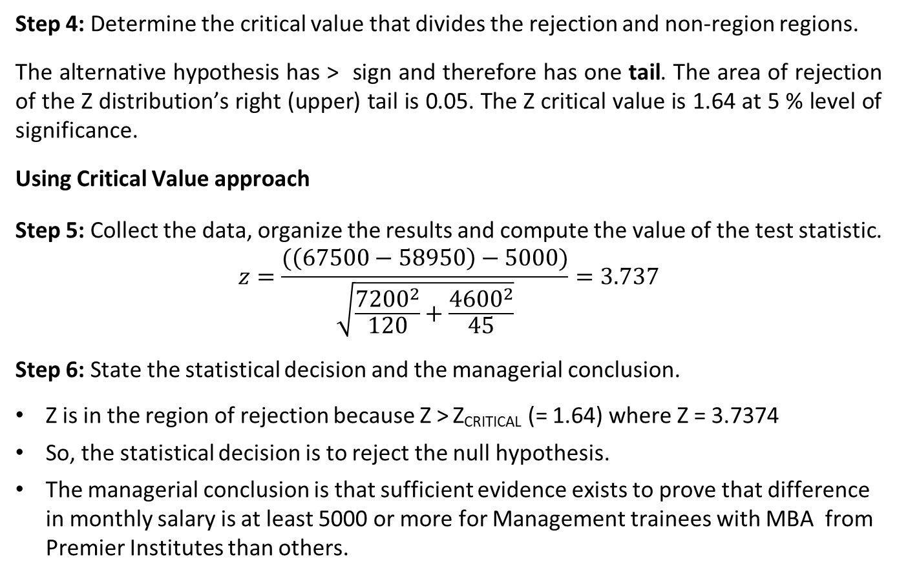
Two-Sample test - Z test for Mean (σ known)
Step 4: Determine the critical value that divides the rejection and non-region regions.
The alternative hypothesis has > sign and therefore has one tail. The area of rejection of the Z distribution’s right (upper) tail is 0.05. The Z critical value is 1.64 at 5 % level of significance.
Using Critical Value approach
Step 5: Collect the data, organize the results and compute the value of the test statistic.
$$z=\frac{(\left(67500−58950\right)−5000)}{\sqrt{\frac{{7200}^{2}}{120}+\frac{{4600}^{2}}{45}}}=3.737$$
Step 6: State the statistical decision and the managerial conclusion.
Z is in the region of rejection because Z > Z_{CRITICAL} (= 1.64) where Z = 3.7374
So, the statistical decision is to reject the null hypothesis.
The managerial conclusion is that sufficient evidence exists to prove that difference in monthly salary is at least 5000 or more for Management trainees with MBA from Premier Institutes than others.

Slide 23
Two-Sample test - Z test for Mean (σ known)
Step 4: Determine the critical value that divides the rejection and non-region regions.
The alternative hypothesis has > sign and therefore has one tail. The area of rejection of the Z distribution’s right (upper) tail is 0.05. The Z critical value is 1.64 at 5 % level of significance.
P Value approach
Step 5: Collect the data, organize the results and compute the value of the test statistic.
P-value = 9.296022e-05
Step 6: State the statistical decision and the managerial conclusion.
Since P-value (= 9.296022e-05) < 0.05 (our level of significance), we reject null hypothesis.
The managerial conclusion is that sufficient evidence exists to prove that difference in monthly salary is at least 5000 or more for Management trainees with MBA from Premier Institutes than others.

Slide 24
Matched/Paired Sample Hypothesis Test
Compare a population parameter such as mean before and after intervention.
In a paired t test, the data related to a parameter is captured twice, once before the intervention and once after the intervention. (Example: Amount of alcohol consumed by people before and after marriage break-up)
Assumptions:
The differences between the estimated parameter before and after intervention follow a normal distribution.
Test statistic, t = (D - µ_{D}) / (S_{D} / √(n)) follows a t distribution with n -1 degrees of freedom.
Here D is the mean difference in the estimated parameter values before and after the treatment
µ_{D} is the hypothesized mean difference and S_{D} is the corresponding standard deviation.

Slide 25
Example of Paired Sample t Test
A researcher believes that Cholesterol level of participants of a meditation program will be lesser after completing the program than before attending the program. Check the claim at 5% level of significance.
Sample size = 50, D = 14 S_{D} = 8.5 µ_{D} = 10 mg/dL
Solution:
Step 1: State the null and alternative hypothesis
H0: µ_{D} ≤ 10
HA: µ_{D} > 10
Step 2: Choose the level of significance, α to be 5% and sample size is 50
Step 3: Choose the appropriate test statistic. Since σ is unknown, you use the t distribution and t as test statistic.

Slide 26
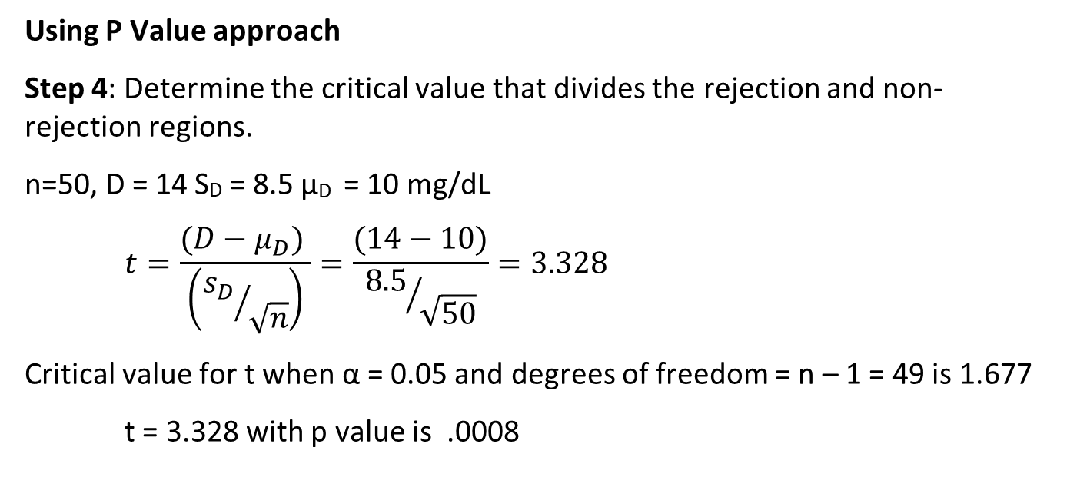
Paired Sample t Test
Using P Value approach
Step 4: Determine the critical value that divides the rejection and non-rejection regions.
n=50, D = 14 S_{D} = 8.5 µ_{D} = 10 mg/dL
$$t=\frac{(D−μ_{D}) }{\left({s_{D}}/{\sqrt{n}}\right)}=\frac{(14−10)}{{8.5}/{\sqrt{50}}}=3.328$$
Critical value for t when α = 0.05 and degrees of freedom = n – 1 = 49 is 1.677
t = 3.328 with p value is .0008

Slide 27
Paired Two-Sample t test
Step 6: State the statistical decision and the managerial conclusion.
t is in the region of rejection because p value (= 0.0008) < 0.05
So, the statistical decision is to reject the null hypothesis.
The managerial decision is that sufficient evidence exists to prove that cholesterol level of participants of meditation program reduces at least by 10 mg/dL after attending the meditation program at 5% level of significance.

Slide 28
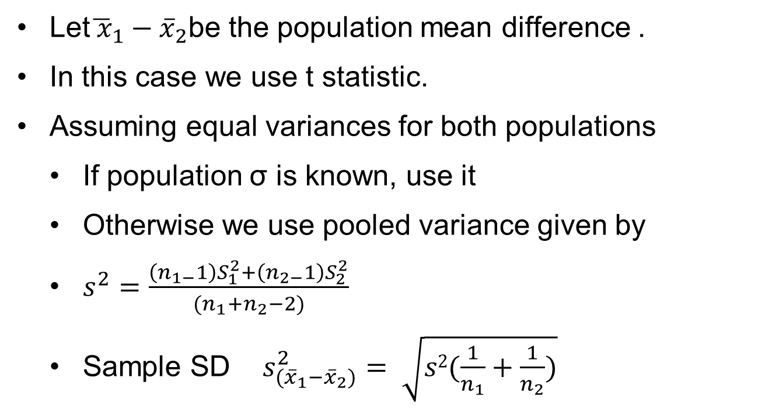
Testing for Mean Difference of Two Population
Independent Samples – Small Sample Case
Let${\overline{ x}}_{1}{− \overline{x}}_{2}$be the population mean difference .
In this case we use t statistic.
Assuming equal variances for both populations
If population σ is known, use it
Otherwise we use pooled variance given by
$s^{2}=\frac{\left(n_{1−}1\right)S_{1}^{2}+\left(n_{2−}1\right)S_{2}^{2}}{(n_{1}+n_{2}−2)}$
Sample SD $s_{({\overline{x}}_{1}−{\overline{x}}_{2})}^{2}= \sqrt{s2(\frac{1}{n_{1}}+\frac{1}{n_{2}})}$

Slide 29
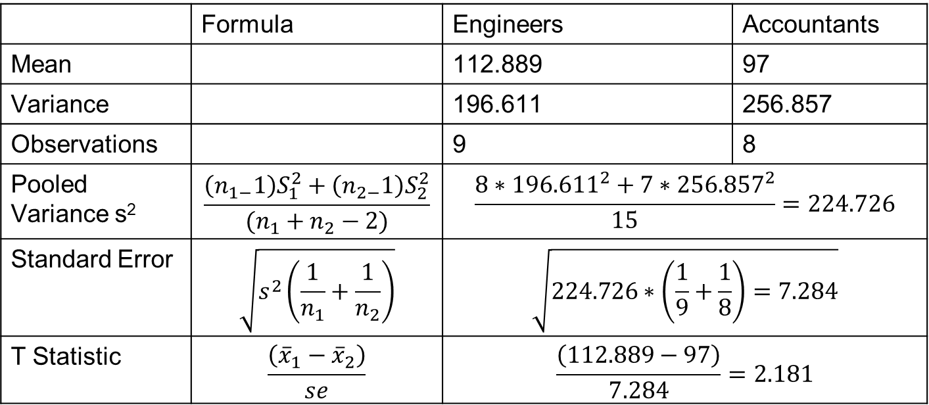
Independent Sample t Test
An aptitude test was conducted in which groups of engineering and accounting executives participated. Is there a significant difference in the performance the groups?
Scores
Engineers | 125 | 115 | 119 | 85 | 97 | 107 | 125 | 125 | 118
Accountants | 112 | 98 | 109 | 96 | 77 | 70 | 114 | 100
 | Formula | Engineers | Accountants
Mean |  | 112.889 | 97
Variance |  | 196.611 | 256.857
Observations |  | 9 | 8
Pooled Variance s² | $$\frac{\left(n_{1−}1\right)S_{1}^{2}+\left(n_{2−}1\right)S_{2}^{2}}{(n_{1}+n_{2}−2)}$$ | $$\frac{8∗{196.611}^{2}+7∗{256.857}^{2}}{15}=224.726$$
Standard Error | $$\sqrt{s^{2}\left(\frac{1}{n_{1}}+\frac{1}{n_{2}}\right)}$$ | $$\sqrt{224.726∗\left(\frac{1}{9}+\frac{1}{8}\right)=7.284}$$
T Statistic | $$\frac{\left({\overline{x}}_{1}−{\overline{x}}_{2}\right)}{se}$$ | $$\frac{\left(112.889−97\right)}{7.284}=2.181$$

Slide 30
Independent Sample t Test
Solution:
t-Test: Two-Sample Assuming Equal Variances
 | Engineers | Accountants
Mean | 112.889 | 97
Variance | 196.611 | 256.857
Observations | 9 | 8
Pooled Variance | 224.726
Hypothesized Mean Difference | 0
df | 15
t Stat | 2.181
P(T<=t) one-tail | 0.023
t Critical one-tail | 1.753
P(T<=t) two-tail | 0.045
t Critical two-tail | 2.131
This is a 2 Tail Test. Since positive t > t_{critical}, we reject null hypothesis. There is significant difference is performance.

Slide 31
Hypothesis Testing Under Decision Making Situation
The NULL (H₀) and ALTENATE (H_{a}) hypotheses are competing statements.
Only one of them can be true but not both.
An ideal testing procedure should lead to acceptance of H_{o} when it is true and rejection when false.
Unfortunately, there is always an error in estimating true location of population mean and therefore we may not arrive at correct conclusion every time.
The table below shows what can happen in making decisions based on a hypothesis test.

Slide 32
Proportions Test

Slide 33
Test for proportion
When the outcome is discrete or dichotomous (success or failure), the test objective is :
Compare the proportion of successes (P-hat or P) in a single population to a known proportion (P₀)
This test will assess whether or not a sample from a population represents the true proportion from the entire population.
The proportion P-hat is calculated using the ratio of no. of successes to the sample size (n)
P-hat = x/n

Slide 34
Standard Deviation and Z score for Test of proportion
Standard deviation (σ) of the sampling distribution σ = sqrt[ P₀ * ( 1 - P₀ ) / n ] where P₀ is the hypothesized value of population proportion in the null hypothesis, and n is the sample size.
Test statistic. The test statistic is a z-score (z) defined by the following equation.
z = (P - P₀) / σ where P₀ is the hypothesized value of population proportion in the null hypothesis, P is the sample proportion (sometimes referred to as P-hat), and σ is the standard deviation of the sampling distribution.

Slide 35
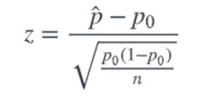
Test of proportion with One Sample - Critical Value Approach
State the null hypothesis H_{o} and the alternative hypothesis H_{A}.
Calculate the test statistic:
where p0 is the null hypothesized proportion i.e., when H_{o}: P=P₀
P-hat is the sample proportion
Determine the critical region.
Make a decision. Determine if the test statistic falls in the critical region. If it does, reject the null hypothesis. If it does not, do not reject the null hypothesis.

Slide 36
Test of proportion with One Sample - p-Value Approach
State the null hypothesis H_{o} and the alternative hypothesis H_{A}.
Calculate the test statistic:
where p0 is the null hypothesized proportion i.e., when H_{o}: P=P₀
P-hat is the sample proportion
Calculate the p-value.
Make a decision. Check whether to reject the null hypothesis by comparing p-value to α. If the p-value < α, then reject Ho; otherwise do not reject Ho.

Slide 37
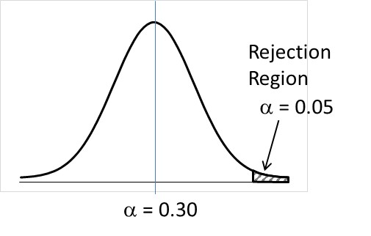
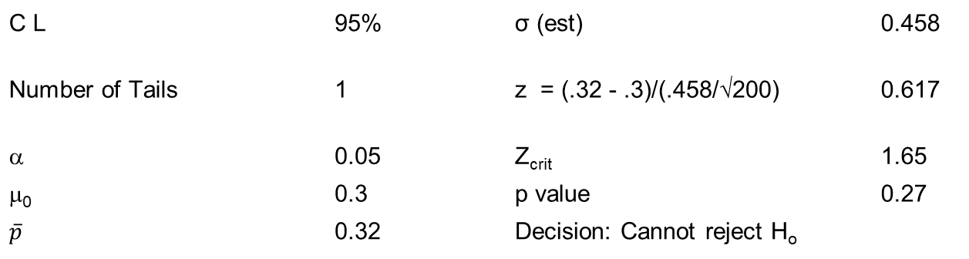
Hypothesis Testing – Proportions
A marketing manager wants to introduce a new product. A blind comparison test is made with a sample size of 200 to assess customer acceptance of the product. The product will be launched only if favorable response is 30% plus. The product found favor with 64 respondents. Should the product be launched?
H_{o}: p ≤ .3 (μ₀)
H_{a}: p > .3 (μ₀)
C L | 95% |  | σ (est) | 0.458
Number of Tails | 1 |  | z = (.32 - .3)/(.458/√200) | 0.617
α | 0.05 |  | Z_{crit} | 1.65
μ₀ | 0.3 |  | p value | 0.27
$$\overline{p}$$ | 0.32 |  | Decision: Cannot reject H_{o}

Slide 38

Test of proportion with Two Independent Samples
Objective:
Compare proportions of successes between the two groups. The relevant sample data are the sample sizes in each comparison group (n₁ and n₂) and the sample proportions (P₁-hat and P₂-hat) which are computed by taking the ratios of the numbers of successes (x₁ and x₂) to the sample sizes in each group, i.e.,
Test Statistic :
where
and

